Slide 1
News Reader
Made By:
1. Akash Singh(20070124055)
2.Anubha Gupta(20070124060)
3.Sahil Gupta(20070124073)
4.Manasvi Mishra(20070124058)
5.Ishan Sinha(20070124066)
PPS Project
(Symbiosis Institute of Technology)

Slide 2
Motivation
01
Behind building a python news
reader

Slide 3
Objectives
With the help of Python build an application that reads out news headline from various sources.
Collect news headlines via NewsAPI
Using python to interact with Microsoft speech sdk to convert speech to text
Creating a time effective way to listen to top news any time

Slide 4
Motivation Behind
MULTI-SOURCED
HEADLINES
ECO-FRIENDLY
Consuming only headline news that matters for time saving
Replacing traditional NewsPapers with a reader that takes less toll on the our planet earth
Using NewsAPI for multiple sources to get current news from any topic

Slide 5
Background Information
02

Slide 6
What is NewsAPI?
Is a simple JSON based REST API for searching and retrieving news articles from all over the world.
Using this one can search top running new stories on a specific topic(keywords).
News can be retrieved based on some criteria.
This stores all the top headlines in a dictionary and once a keyword or a related topic is searched it retrieves news concerned.

Slide 7
01
02
03
Easy To Use
Quick
Vast Resources
Why NewsAPI?
When retrieving top headlines from the net we have a lot of API’s to choose from like Bing News Search , New York Times API, Bloomberg etc. All of these have very useful API programs. So why did we choose NewsAPI?

Slide 8
Proposed
Methods
03
(library/modules used)

Slide 9
JSON Module:
This module contains functions for working with json data
Javascript object notation (json) is a standardized format commonly used to transfer data as text that can be sent over a network.
Python supports json natively! python comes with a built-in package called json for encoding and decoding json data
Json represents objects as name/value pairs, just like a python dictionary

Slide 10
Request Module
The requests module allows us to send HTTP requests using Python
Python requests module has several built-in methods to make http requests to specified URL using get, post, put, patch or head requests
In this program our we have used get function of request module to request a resource from news API server
The GET request is only used to receive the data from server

Slide 11
Trying to convert text to speech in PYTHON!
There are several APIs available to convert text to speech in python. One of such APIs available in the python library commonly known as win32com library.
It provides Dispatch method
It interacts with microsoft’s speech sdk
Converts written text to speech
Install using cmd : pip install pypiwin32

Slide 12
Results
04

Slide 13

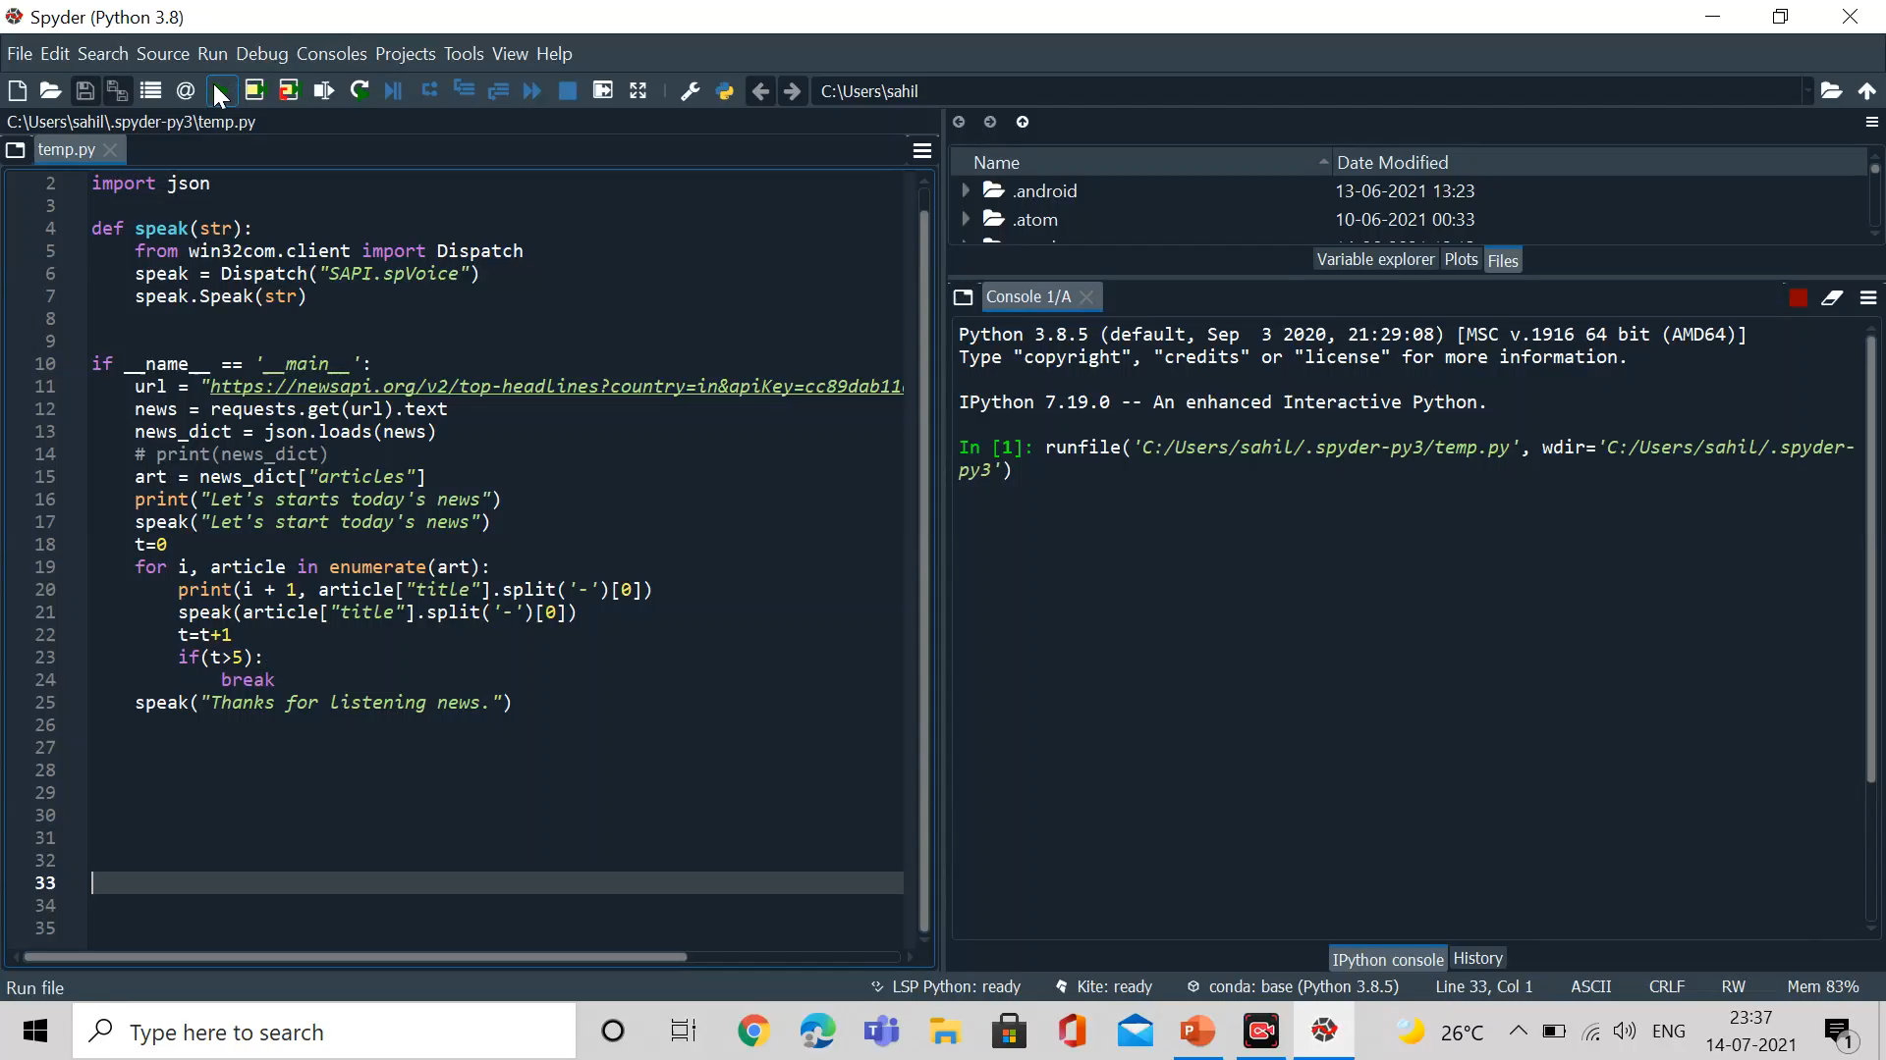
OUTPUT:
This is how the news reader works..
Could also be run on the command prompt by directly running them from folders

Slide 14
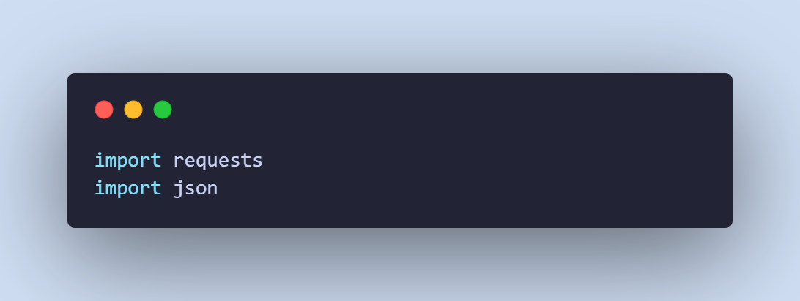
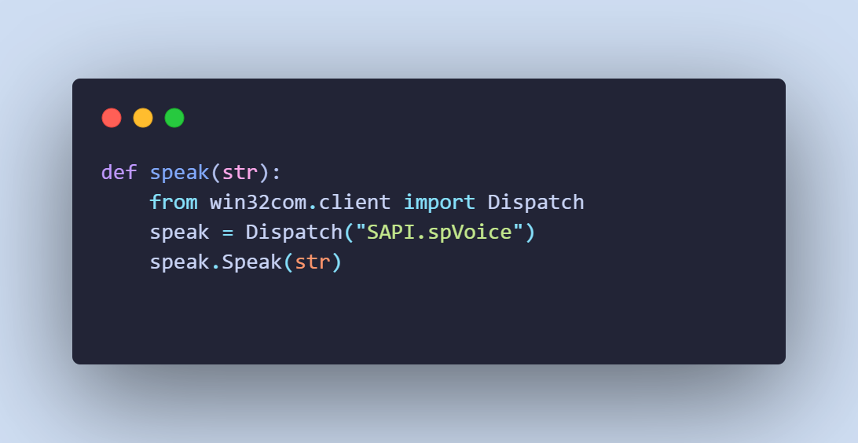
Code Snapshot
Importing modules
Speak function
( to convert news text to speech )

Slide 15
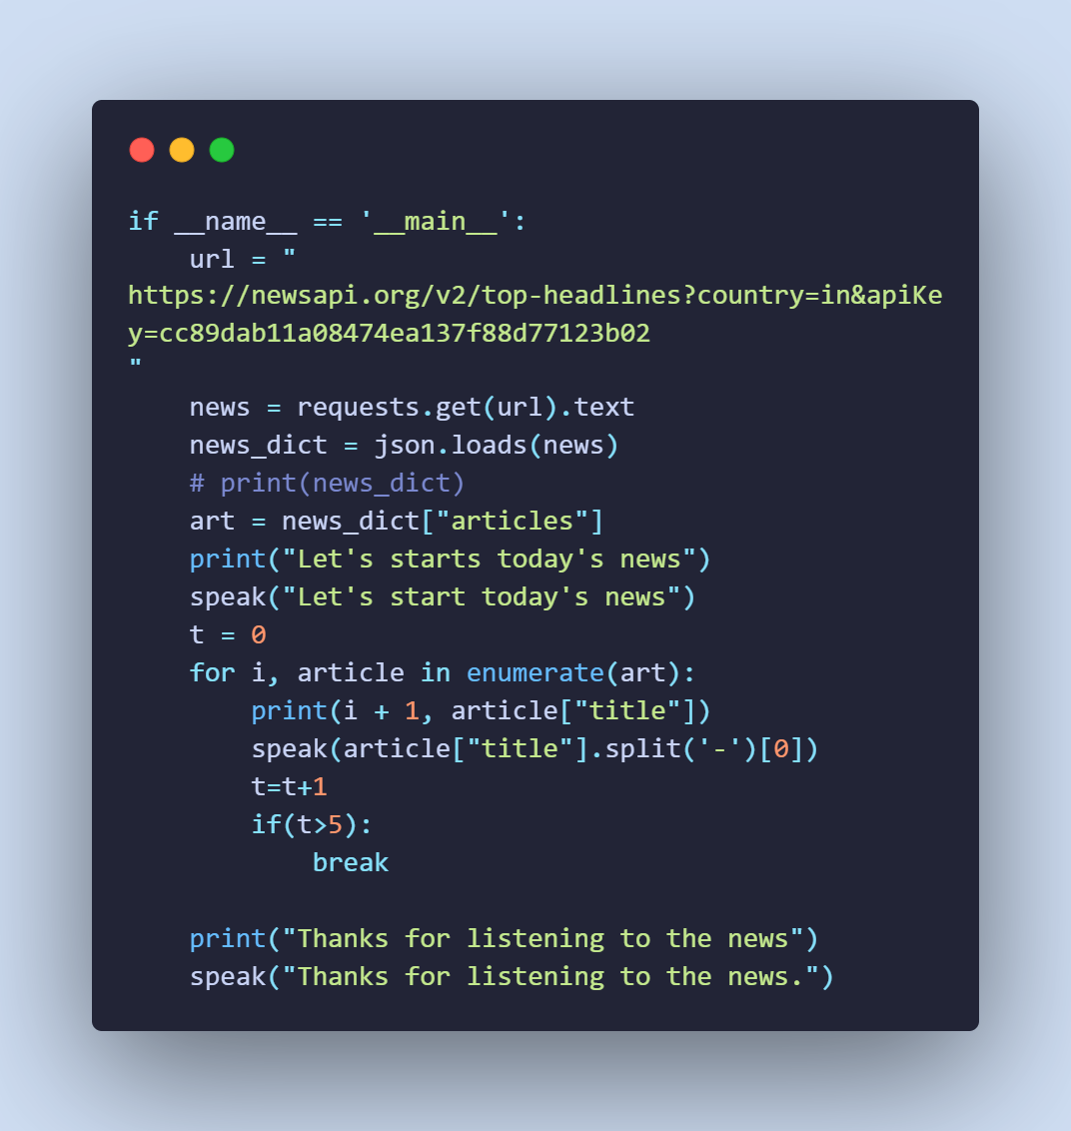
Code Snapshot
Using news API to fetch
news

Slide 16
Algorithm
Start
Import json and request libraries
Creating speak function to accept string from parsing JSON library and sending it separate headlines
Make main script that accepts news API URL and parses the raw JSON file
Convert the JSON to python dictionary
Iterate the dictionary for news headline to and pass them to speak function for it to be read aloud
end

Slide 17
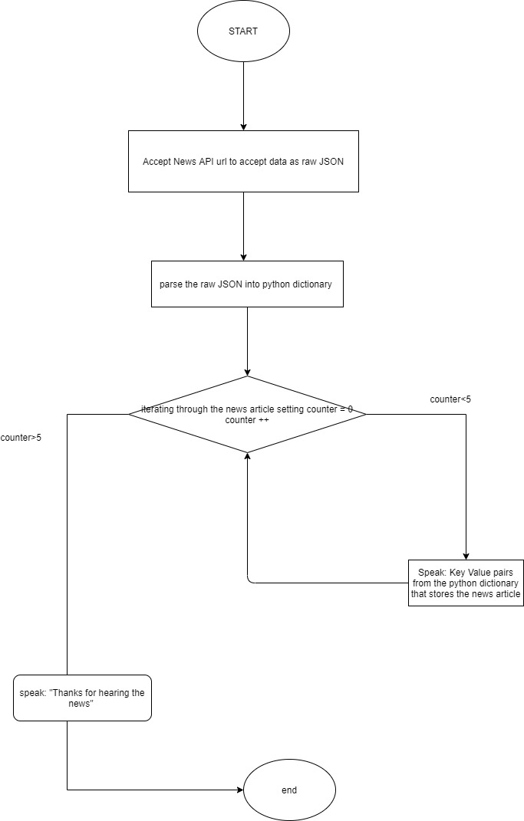

Slide 18
Summary &
Future Works
05

Slide 19

Every end user is a customer,
so to save time of reading, enhance customer experience, for global market penetration and more autonomy for the digital content owner, this algorithm, ‘News API’ is created. So, with the help of python, this algorithm is coded as it is easy to read, has improved productivity and most importantly has vast libraries support. With the use of requests library (for https requests), json (for data flow) and win32com library(for converting text to speech),we have come up with this news reader.

Slide 20
Future! 🚀
What can be the possible future works for News Reader? Here are a few..
Optimising algorithm to stay informed about the full news just by key topics rather than reading it from a variety of viewpoints
Going deep, algorithm could be modified so to automatically archive the stories once read to keep you focused on what’s new
Algorithms when optimised smartly will not just help reading the news but also can translate it to other languages also

Slide 21

Thanks!!

